Slide 1
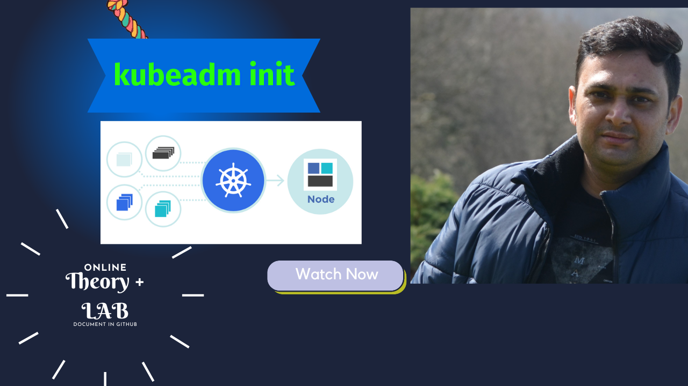
Notes:
Hello everyone. My name is Anish Rana and today you are watching Kubernetes web series.
As of now, we have successfully completed some topics. If you have not watched those previous videos, then you may click on I button.
Just for your information, this power point document can be downloaded from my Github page. Besides this, subtitle for different language, such as English, French, Russian and German, is available for this video.

Slide 2
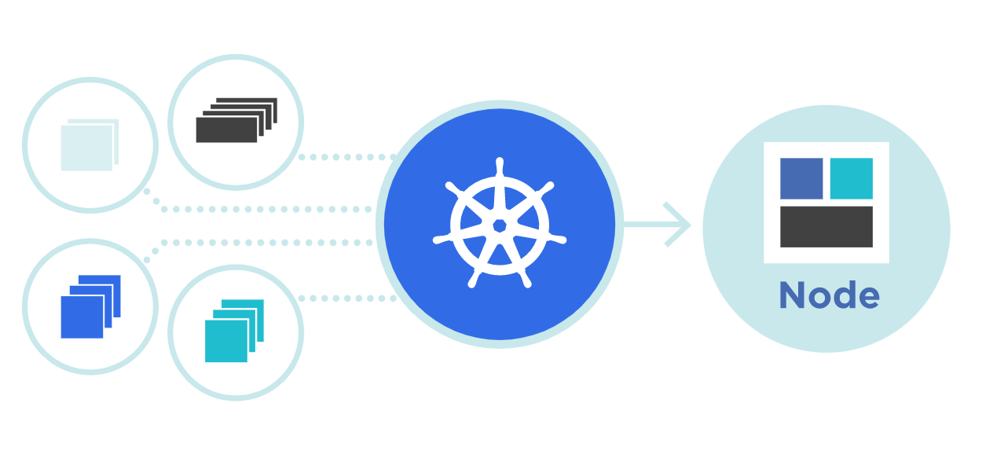



kubeadm init
Theory + LAB + Documents ➔ All free
WATCH NOW
Notes:
Today, we're going to cover one interesting topic, i.e. “How to build Kubernetes cluster?"
we are talking about how to create a Kubernetes cluster. We will cover the theory part. In which I will try to cover all those commands that I will execute on lab section.
I believe that theory part is curtail because we will get the know “why we are executing these commands”?

Slide 3
Contact Details: - Anish Rana - Contact Hours: 9am-3pm, Sat & Sun - Linkedin: www.linkedin.com/in/anishrana2001 Github: https://github.com/anishrana2001/Kubernetes/tree/main/Kubernetes%20init
Notes:
If you want to reach me out then, these are details you may use.

Slide 4
Course Outline
- How to create Kubernetes cluster
- Prerequisite ?
- Smooth installation on CentOS 9 Stream OS
- Manual and Script
- LAB
Notes:
So, today, I will walk you through How to build the Kubernetes cluster.
Before that, we will discuss the prerequisites for this
how to do smooth installation on CentOS 9 Stream OS.
Through manual and script. To explain more, we will do the manual steps on our master node and then use script to install the Kubernetes cluster on Workernodes.
All these steps we will perform on live, it means on LAB.
Let’s start with Prerequisites first and open the curtains.

Slide 5
VM Requirement in Kubernetes Cluster?
Linux VM1
Linux VM2
Linux VM3
2 GB RAM
2 GB RAM
2 GB RAM
2 Core CPU
2 Core CPU
2 Core CPU
20 GB Hard Disk
20 GB Hard Disk
20 GB Hard Disk
swapoff
swapoff
swapoff
Switch/ Router / Cloud
Notes:
Our First topic is “VM requirement in Kubernetes cluster?”
A compatible Linux Host machines.
Minimum 2 GB RAM, if you allocate less, you will have less room for your application.
2 CPUs will be enough. However, if you give more, it would be good.
For this cluster, I will assign 20 GB hard disk.
Swap must be disable.
Full connectivity between your cluster, whether it will be in your public or Private network.
Unique Hostname, mac address and so on.

Slide 6
Commands to check the requirement?
For RAM
cat /proc/meminfo
[root@master1 ~]# cat /proc/meminfo
MemTotal: 2266316
MemFree: 1265064 kB
MemAvailable: 1610392 kB
Buffers: 3200 kB
Cached: 462552 kB
SwapCached: 0 kB
Active: 126492 kB
Inactive: 657896 kB
Active(anon): 1840 kB
Inactive(anon): 329644 kB
Active(file): 124652 kB
Inactive(file): 328252 kB
Unevictable: 0 kB
Mlocked: 0 kB
SwapTotal: 1952764 kB
SwapFree: 1952764 kB
Dirty: 0 kB
Writeback: 0 kB
AnonPages: 309492 kB
Mapped: 198000 kB
Shmem: 12848 kB
KReclaimable: 49732 kB
Slab: 99980 kB
[root@master1 ~]#
cat /proc/meminfo | grep MemTotal | awk '{print ($2 / 1024) / 1024 ,"GiB"}’
MemTotal: 2266316 kB
[root@master1 ~]# cat /proc/meminfo | grep MemTotal | awk '{print ($2 / 1024) / 1024 ,"GiB"}'
2.16133 GiB
[root@master1 ~]#
Notes:
Commands to check the requirement.
In order to check the RAM, we can execute the command “cat /proc/meminfo”.
However, this command produce too many information.
we are interested only on MemTotal. This command gives us the information in KB. In order to change to GB, we can use awk command and divided by 1024, 2 times.
If I execute this command, it tell us 2.16 GB. It means our RAM requirement is fulfilled.
Next is CPU.

Slide 7
Commands to check the requirement?
cat /proc/meminfo | grep MemTotal | awk '{print ($2 / 1024) / 1024 ,"GiB"}’
For RAM
cat /proc/meminfo
For CPU
cat /proc/cpuinfo | grep processor
[root@master1 ~]# cat /proc/cpuinfo | grep processor
processor : 0
processor : 1
[root@master1 ~]#
Requirement
2 Core CPU
Notes:
We can execute the command “cat /proc/meminfo | grep processor” to identify how many CPUs are being allocated to this machine.
If I execute this command, it produce 0 and 1, it means that we have 2 CPUs allocated.
Please bear in mind that we need at least 2 CPUs. We can say that our requirement is fulfilled.
Next is,

Slide 8
Commands to check the requirement?
cat /proc/meminfo | grep MemTotal | awk '{print ($2 / 1024) / 1024 ,"GiB"}’
For RAM
cat /proc/meminfo
For CPU
cat /proc/cpuinfo | grep processor
Disable the Swap permanently
sed -i '/ swap / s/^\(.*\)$/#\1/g’ /etc/fstab
Disable the swap for current session
swapoff -a
Disable the Selinux
SELINUX=disabled
Edit the /etc/hosts file, As we are not using DNS
Disable the Firewall services
Install the Runtime engine i.e., Docker engine
Install the Kubernetes Packages i.e kubelet kubeadm kubectl
Notes:
How to disable the Swap permanently.
we can use “SED” command. This command, first search the “swap” key word. If it finds, then it will add hash in the beginning of the line. It means this line will me comment.
Now, the question is “how to disable the swap for current session?”. For this we have “swapoff –a” command.
In our lab, we will disable the selinux because we want to get rid off from selinux context errors.
As of now, we are not using DNS servers, thus, we will use “/etc/hosts/” file for name resolution.
For the first time, we will be disabled the firewall services and then in my upcoming topic, I will enable the firewall services.
Once all the prerequisites full filled then we will install the Runtime engine. In our case, we will use Docker engine.
I have already uploaded Docker vides, if you have not watched those video, and wish to watch them then check the description on this video. I have added the link.
Last but not least, install the Kubernetes packages. i.e. Kublet , Kubeadm and Kubectl , people also call it kubectl

Slide 9


Worker node 1 / VM
Master node 1 / VM
Schedular
POD 1
C: webapp1
Kubelet
API Server
Etcd Database
Kube-Proxy
POD 2
C: database1
Controller
Kubernetes
Kubernetes
Docker Engine
Docker Engine
CentOS 9
CentOS 9
Notes:
In this slide, we have the complete picture.
Frist install the CentOS9 , Video already uploaded.
Today, we will install the Docker engine and then Kubernetes packages.

Slide 10
Kubernetes packages
kubelet
kubeadm
kubectl
Notes:
As mentioned in the previous slide, we will install these the packages.
Lets’ have a look into these packages. First one is Kubelet.

Slide 11
Kubelet
Kubelet is an agent, which runs on each worker node.
Primary use is to register the node with the API server.
Kubelet interacts with both the container, container runtime (Podman / Docker) and the node.
Create/Run/Destroy PODs on the worker nodes based on POD spec (yaml file) receives from API server.
Reports the status of PODs & nodes to the API server.
Notes:
I have already coved this topic in my previous video, you will observe the link in description.

Slide 12
kubeadm
With the help of “kubeadm” command we can setup / create our Kubernetes cluster.
Kubernetes-specific command line tool which help us to communicate and control Kubernetes cluster.
kubectl
Notes:
When we install the kubeadm package, it will provide us the kubeadm command.
Kubeadm is a command/tool used to build Kubernetes (K8s) clusters. Kubeadm performs the necessary actions to get a minimum viable cluster up and running quickly.
kubectl : kubectl is the Kubernetes-specific command line tool that lets you communicate and control Kubernetes clusters. With the help of this command, you can create, manage, or delete resources on your Kubernetes platform.

Slide 13
LAB
Notes:
It’s time to jump into our lab section where we will perform all these steps.

